Slide 2
E-business Defined
E-Business (electronic business) is any process that a business organization conducts over a computer-mediated network. Business organizations include any for-profit, governmental, or nonprofit entity.
Their processes include production-, customer-, and internal- or management-focused business processes.

Slide 3
Electronic commerce focuses on the use of information and communication technology to enable the external activities and relationships of the business with individuals, groups, and other businesses, while e-business refers to business with help of the internet.
Electronic business differs from electronic commerce as it does not only deal with online transactions of selling and buying of a product and/or service but also enables to conduct of business processes (inbound/outbound logistics, manufacturing & operations, marketing and sales, customer service) within the value chain through internal or external networks.
The term "e-business" was coined by IBM's marketing and Internet team in 1996

Slide 4
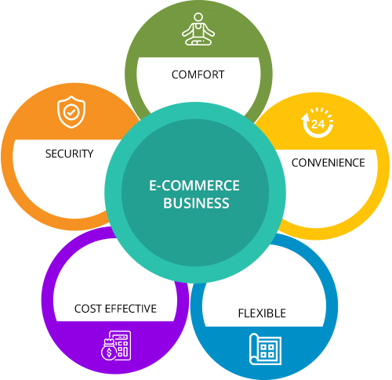
Why ????

Slide 6
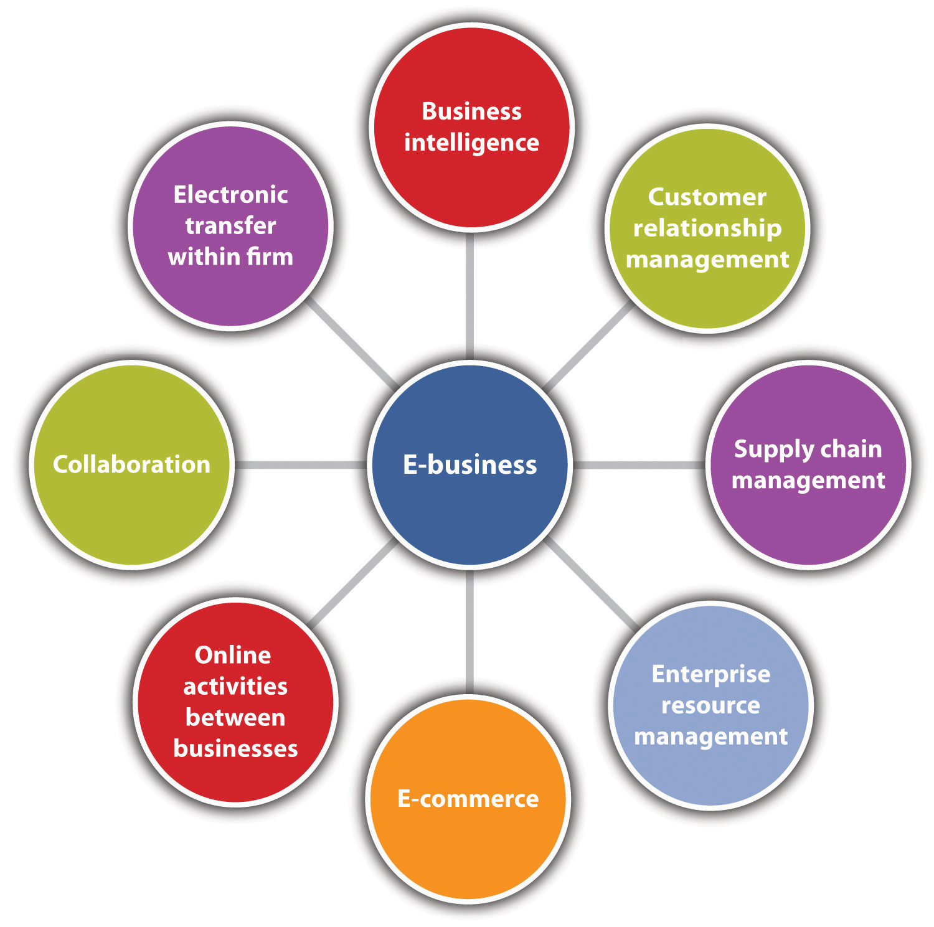

Slide 7
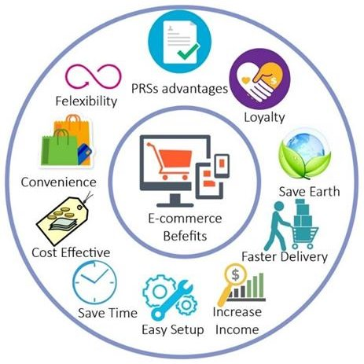

Slide 8
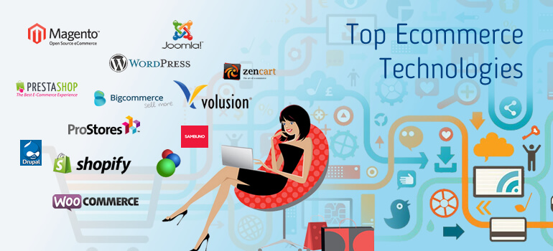

Slide 9
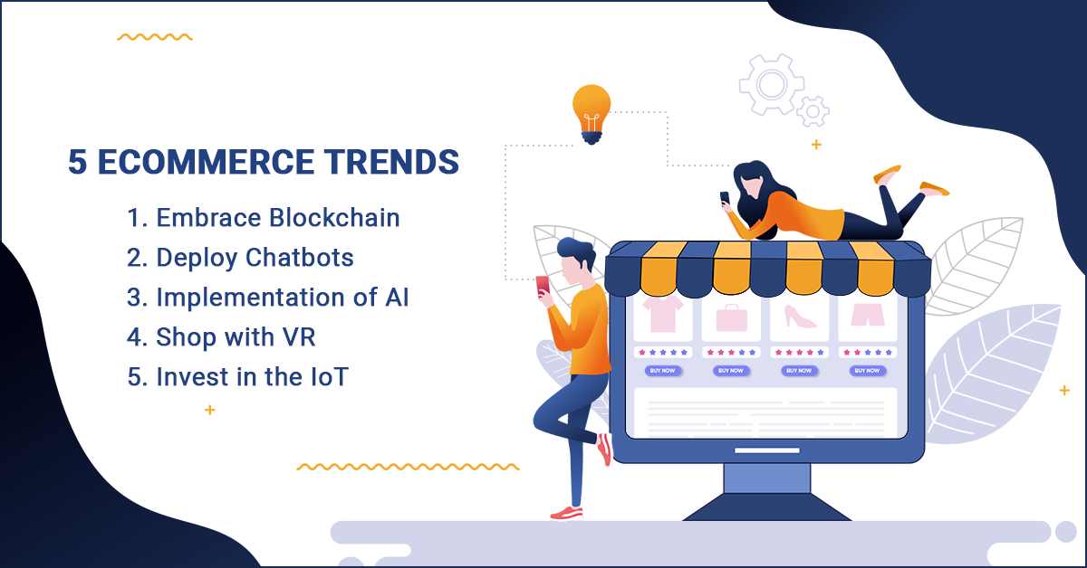

Slide 12
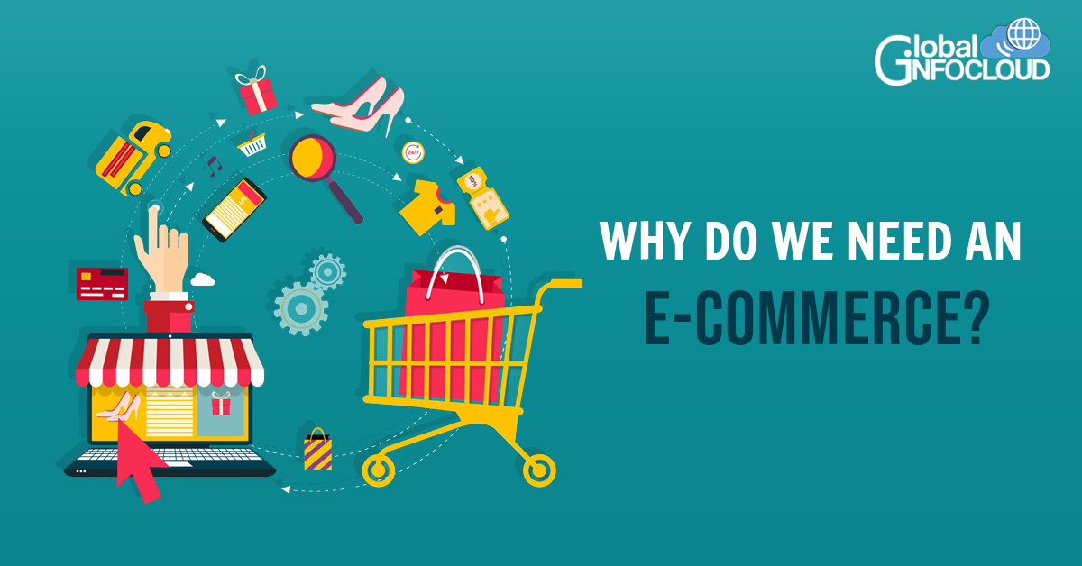

Slide 13
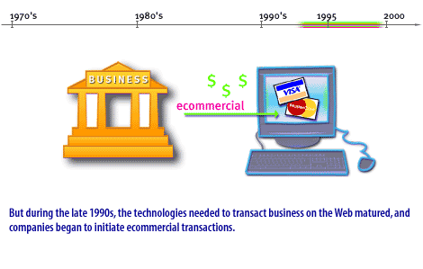

Slide 14
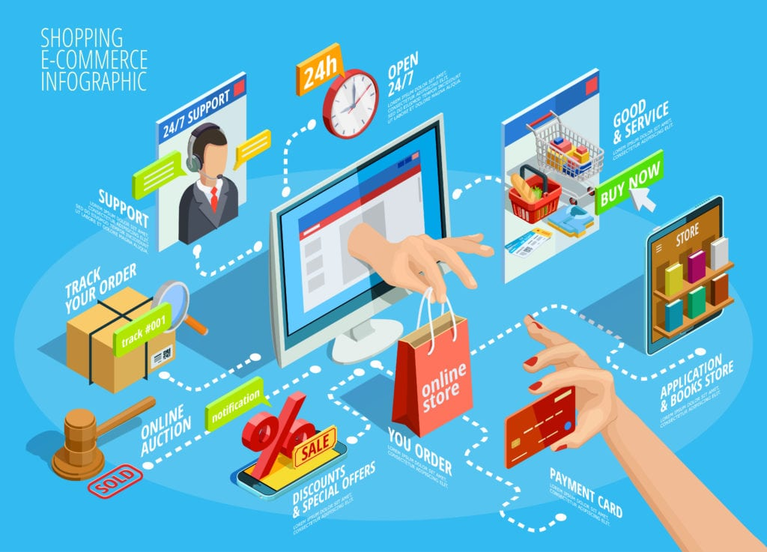

Slide 15
objectives for e-business Development
The organization is facing market changes and the organization changes according to the markets.
The objectives for the e-business development emerge from these changes and because the change is continuous, it brings new requirements for the e-business system. In addition, the history and legacy structures of the organization cause conflicts in the development when combined with the need for change. These fluctuating objectives and emerging conflicts bring certain consequences to the e-business system architecture development in the organization. The formation and description of this causal model can be classified as selective coding..
In summary, e-Business has been in the making for the past 30 years. After starting as a niche solution for certain businesses and communities, e-Business today is an expanding force accounting for a steadily increasing share of commercial transactions. Its full potential remains in the future. Now you know how e-Business came to be as important as it is. The next lesson is about the direction in which e-Business moving.

Slide 16
The history of e-commerce: A long and winding road
When considering time itself, the history of e-commerce is fairly short, but for most of us, the idea of life without online shopping is virtually inconceivable.
From groceries to diamonds to services to Enterprise Level Product Solutions, almost anything you can imagine can be purchased electronically.
But where did it all begin, and how far will it go?

Slide 19
The history of e-commerce: 1960s – 1980s
For beginning just a short while ago, the history of e-commerce is dramatic. In 1969, CompuServe was the first major e-commerce company to be formed in the United States. Although it seems distant now, computer time-sharing services grew from email providers to facilitating tele-shopping in the 1970s.
While the rest of us were just beginning to celebrate the wonder of cable television at the beginning of the 1980s, some tech savvy users formed the Boston Computer Exchange, which was a bulletin board system-based marketplace established to facilitate the sale or trade of used computers. This company was a trailblazer in crafting a fully automated, on-line auction and marketplace for general commerce.

Slide 20
For many years, e-commerce existed quietly, but in 1990, the first web browser, aptly named “WorldWideWeb,” was launched.
Around this time, development of the internet kicked into high gear, going from the ability to display basic style sheets to the launch of Amazon and eBay within just a few short years. Needless to say, those two have become smashing successes as they evolved into massive e-commerce platforms, selling and enabling consumers to sell their own wares to others on a global scale, as well as to subscribe to items they need – no more going to the store to purchase standard household goods.
By the late 1990s, we were all getting too much email, and DVDs began to outpace VHS tapes as the preferred method of viewing films – but that didn’t last long.
In 1997, we saw the launch of Netflix as the world’s first online movie rental store.
Building their reputation on the model of flat-fee unlimited rentals without due dates, late fees, shipping and handling fees or per-title rental fees, Netflix wittingly upped the customer service game of all would-be online merchants while turning the entertainment industry on its head.
Just one year later, Paypal, in its first iteration as Confinity, entered the scene as a tool for transferring money. The company now functions as a bank that executes payment processing for online vendors, auction sites, personal, and commercial users. It’s a service that allows their customers to send, receive, and hold funds in 26 currencies worldwide. Today, Paypal Holdings, and its subsidiary, Venmo are two huge names in the digital wallet game.

Slide 22
2nd lecture
MBA SEM 2
E –BIZ
UNDERSTANDING TYPES OF BUSINESS MODELS

Slide 23
Global E-Business retail sales surged 25.7% in 2020 to $4.213 trillion. Five, ten, or even twenty years ago this probably seemed like an impossible number to reach. E-Business has exploded over the last few years and even with the end of the COVID-19 pandemic in sight, isn’t expected to slow down.
The digital shift is a very real trend and businesses not already online will need to break into the E-Business landscape sooner rather than later. Applying the right E-Business business model to the online store will be one of the first steps.
Not taking the time to evaluate your business and understand your target market can be extremely detrimental and lead to thousands in wasted spend. Digital advertising, SEO, and content marketing are effective ways to drive traffic, revenue and help you realize a large ROI, but they won't be nearly as effective without a well-planned E-Business business strategy.
Whether you’re just starting to explore E-Business models or already have an established digital commerce venture and are looking to expand your online presence, it’s important to know which model best fits your needs and requirements

Slide 24
“Developing an E - Business strategy is a crucial piece for many organizations. A huge component of this is identifying your target market and understanding what your E - Business business model will be “
And thus let us First of all understand
Types of Business Models

Slide 25
Types of Business Models
Electronic commerce, or E-Business, is a business model that lets businesses and consumers make purchases or sell things online. There are six major E-Business business models:
Business to Consumer (B2C)
Business to Business (B2B)
Business to Government (B2G)
Business to Business to Consumer (B2B2C)
Consumer to Consumer (C2C)
Consumer to Business (C2B)
We’ll review each of these six business classifications in depth and dig into the five primary delivery models that you will need to consider when launching or expanding your online store.

Slide 27
Business to Consumer (B2C)
As the name implies, business to consumer (B2C) is when a company markets its products or services directly to end users. It is the most widely known form of commerce. B2C E-Business is fairly straightforward. You complete a B2C transaction every time you purchase food from a grocery store, eat dinner at a restaurant, watch a movie at a theater, and get a haircut. You are the end user of the products and services these companies sell.
In E-Business, there are five different B2C business models:
Direct Sellers,
Online Intermediaries,
Advertising-based,
Community-based,
Fee-based.
MARKET PLACE MODEL

Slide 28
B2C Business Models
Direct selling is the most common model. It is when consumers buy products from online retailers.
Online intermediaries are online businesses that bring sellers and consumers together and take a cut of each transaction made.
In the advertising-based model, information is given away for free and money is made from advertising on the site.
Facebook is an example of a community-based site that makes money from targeting ads to users based on their demographics and location.
Finally, the fee-based model involves companies that sell information or entertainment to consumers for a fee, like Netflix or subscription-based newspapers.

Slide 29
Direct selling is the selling of products in a non-retail setting, for example, at home, online, or other venues that are not a store. It eliminates middlemen who are involved in distribution, such as wholesalers and regional distribution centers. Instead, products are sent directly from the manufacturer to the sales company, then to the rep or distributor, and finally to the consumer.
Eg – Amway, Vestige, Proveda
Products sold via direct sales are not typically found in traditional retail locations. This means that finding a distributor or rep is the only way to buy them.
It’s important to note that direct selling doesn’t equal direct marketing. In the first case, individual distributors or reps reach out to customers directly. Meanwhile, in the second case, a company markets directly to clients. Some direct marketing examples include emails, flyers, promotional letters, outdoor advertising, ads, phone calls, websites, and others.
Direct selling characteristics –
Focus on building relationships first, not making sales.
Keep consistent and detailed customer records.
Be passionate and knowledgeable about your products.
Build and maintain your networks
Organize your sales environment.
Improve your sales skills.

